Slide 1

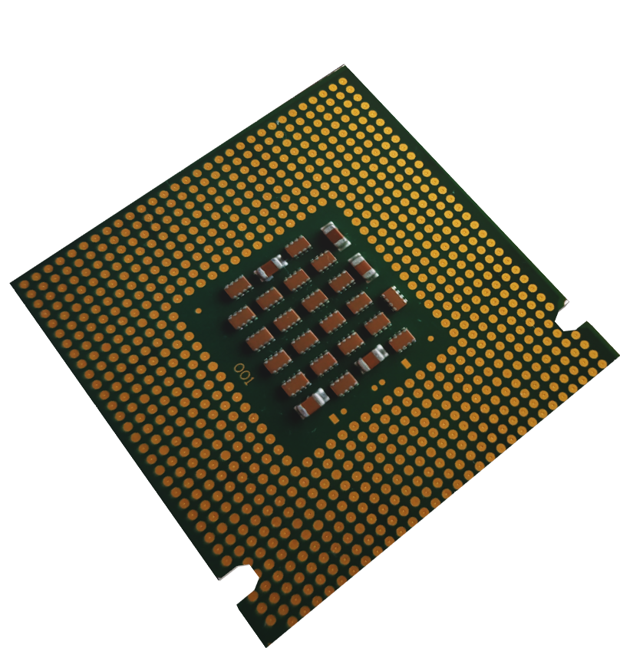
Loan Approval Classification
AI Final Project

Slide 2
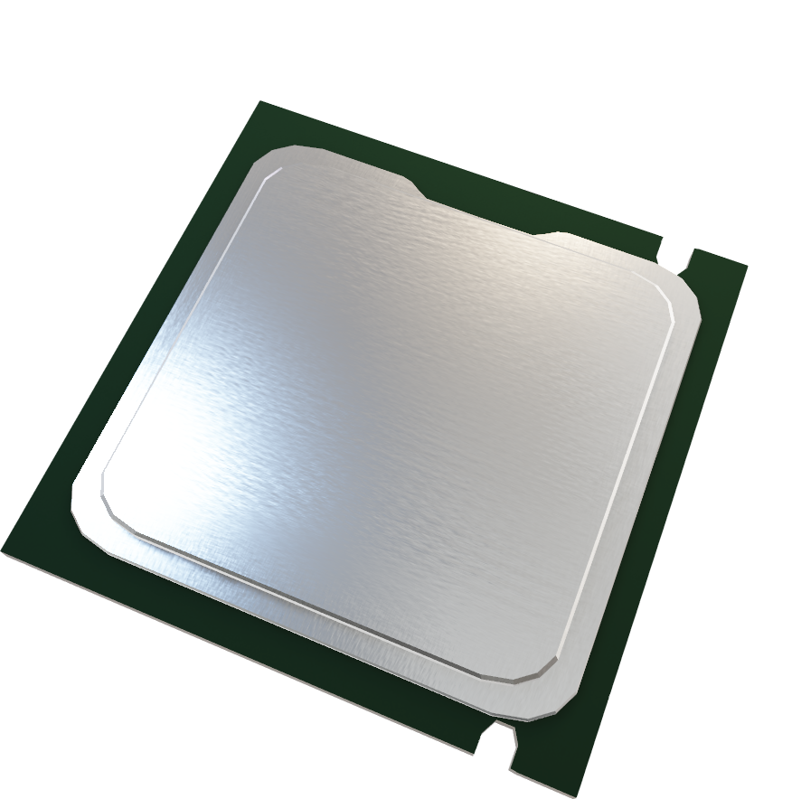
Ai Final Project
Loan Approval Classification
Brian tumor
Team:
Mahmoud Sayed
Omar Mohamed
Anas Ahmed

Slide 3

OUTLINE
Introduction to the project
01
We are going to discuss what this project is about and its purpose.
Objectives
02
The project goals and outcomes
Project phases
03
It will be divided into an CSV Data processing and Image processing
04
Results and Conclusion

Slide 4
Introduction to the project
This project develops a machine learning model to predict The loan approval classification and The Brain Tumor Image Dataset
Our purpose is it to predict whether a loan application will be approved or rejected and identifying brain tumors from a collection of MRI scans By analyzing the dataset and training it

Slide 5
OUTLINE
Introduction to the project
01
We are going to discuss what this project is about and its purpose.
Objectives
02
The project goals and outcomes
Project phases
03
It will be divided into an CSV Data processing and Image processing
04
Results and Conclusion

Slide 6
Objectives
Develop a machine learning model to predict loan approval decisions.
Test the performance of different training model
Prepare the data for the training and predictions.
Prepare the data for the training and predictions.

Slide 7
OUTLINE
Introduction to the project
01
We are going to discuss what this project is about and its purpose.
Objectives
02
The project goals and outcomes
Project phases
03
It will be divided into an CSV Data processing and Image processing
04
Results and Conclusion

Slide 8

Project phases

Slide 9
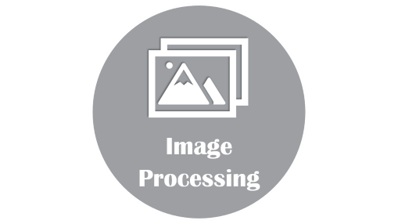
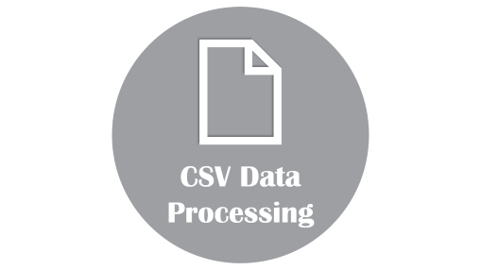
Project phases

Slide 10

CSV Data Processing

Slide 11

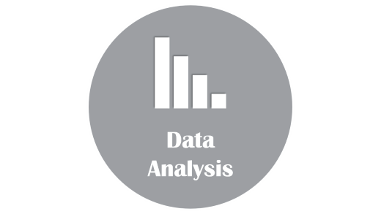
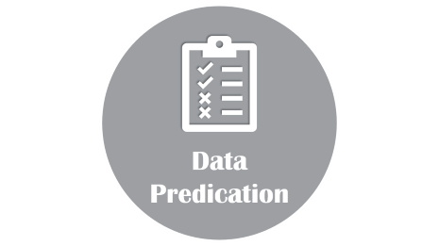
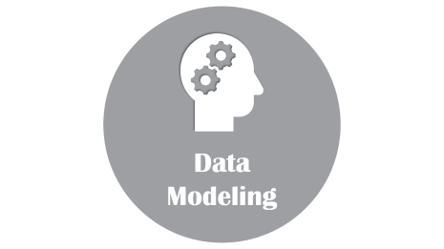
CSV Data Processing

Slide 12

Data Analysis

Slide 13



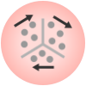
Data Analysis
The first thing we need to do is to analysis the dataset using specific widgets so we can understand it.
correlation
Distributions
Future statistics
FreeViz

Slide 14
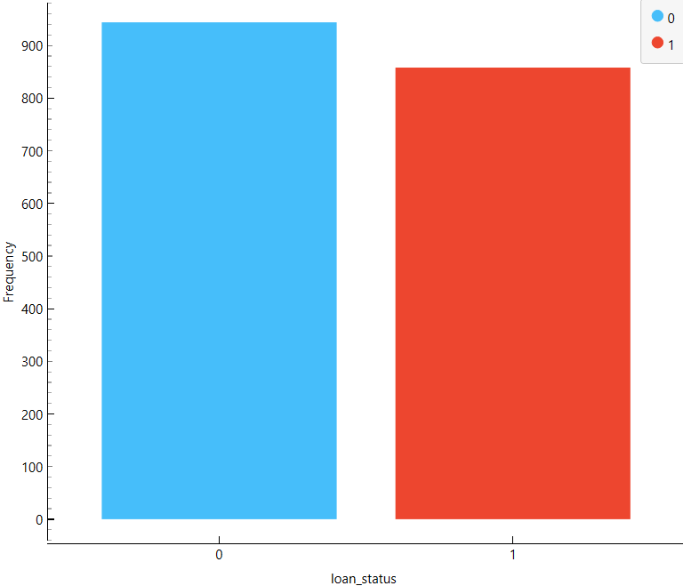
Distributions
From this widget, we can check the Balance of the dataset target
As you can see from the shown figure The balance: NO (52%), YES (48%).

Slide 15
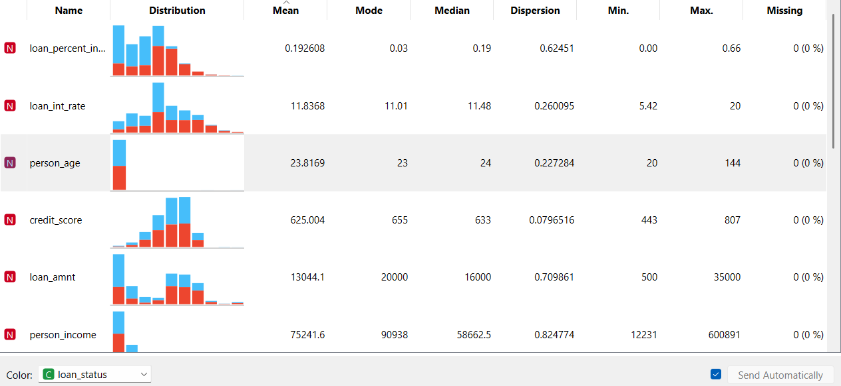
Data Analysis
The first thing we need to do is to analysis the dataset using specific widgets so we can understand it.
correlation
Distributions
Future statistics
FreeViz

Slide 16
Future statistics
This widget provides:
Max, min, mean, median,
and missing values for each feature.

Slide 17
Data Analysis
The first thing we need to do is to analysis the dataset using specific widgets so we can understand it.
correlation
Distributions
Future statistics
FreeViz

Slide 18
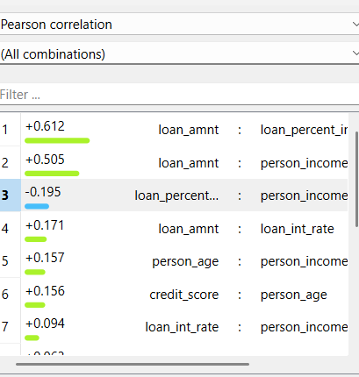
correlation
The Correlation widget indicates whether there is a direct or inverse relationship between features.
Positive (+ve) values indicate a direct relationship.
Negative (-ve) values indicate an inverse relationship.
Correlations with a value greater than +0.7 or less than -0.7 are considered strong correlations.

Slide 19
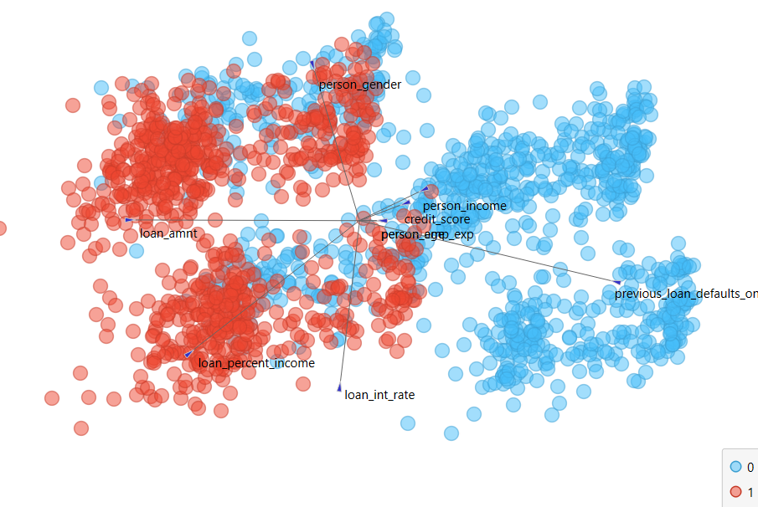
Data Analysis
The first thing we need to do is to analysis the dataset using specific widgets so we can understand it.
correlation
Distributions
Future statistics
FreeViz

Slide 20
FreeViz
Free Viz analyses the features and state the most effective features on target.

Slide 21
Data Analysis
The first thing we need to do is to analysis the dataset using specific widgets so we can understand it.
correlation
Distributions
Future statistics
FreeViz

Slide 22

Data Modeling

Slide 23




Data Modeling
Preparing The Data
In this phase we prepare the dataset for the training and predictions.
there’re some required widgets we can use to prepare it for the training phase.
Data Sampler
Preprocess
Impute
Outliers

Slide 24
Replaces missing values using various methods
This step ensures no records are lost.
Impute
Normalize numeric fields to a range of 0 to 1
Increasing data analysis and prediction accuracy
Preprocess
Identifies and removes abnormal records
Divides data into: Inliers / Outliers
Improves prediction accuracy.
Outliers
Divides data into:
Sample: For training the model
Remaining: For testing and validation.
Data Sampler

Slide 25
Data Modeling
Preparing The Data
In this phase we prepare the dataset for the training and predictions.
there’re some required widgets we can use to prepare it for the training phase.
Data Sampler
Preprocess
Impute
Outliers

Slide 26
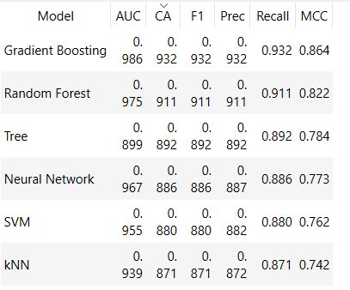
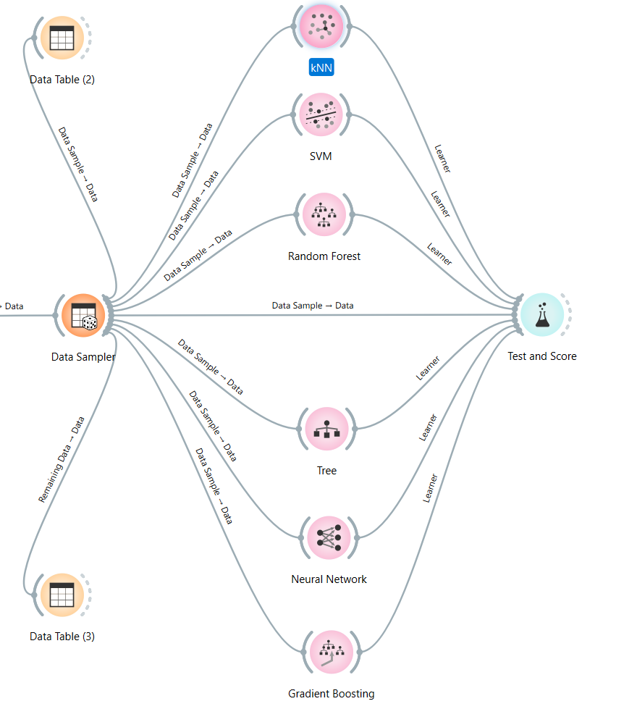

Data Modeling
Data Sampler
Data Training
Our purpose is to Train the dataset to evaluate model performance before prediction.
Models used: KNN / SVM / Random Forest / Decision Tree / Neural Network / Gradient Boosting
Preprocess
Data Testing
Compare trained data against the data sample to test training efficiency.
To do that we use Test and Score widget
Outliers
Impute

Slide 27
Now, we can notice that Gradient Boosting model has the highest “CA” that’s why we will rely on this model in training the sample data

Slide 28
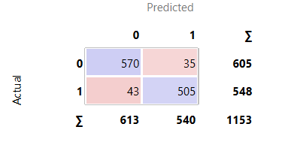
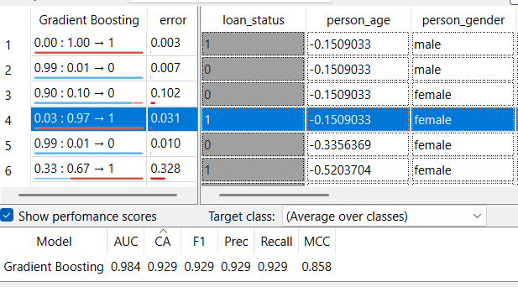
to show the differences between actual data and predicted data we use “Confusion Matrix”
It displays how many instances were classified and misclassified

Slide 29
Now, we will need to predict loan approval for remaining instances to test the learning accuracy
The first thing is Connect the “prediction” widget to the “Gradient Boosting” model (highest classification accuracy).
Send Remaining Data from the Data Sampler to test prediction accuracy

Slide 30

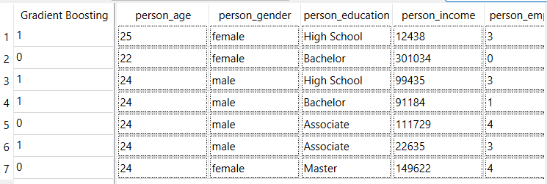
Data Predication

Slide 31
Data Predication
Now we will Open a new Orange file to load the previously saved mode
Apply the model to new records without a target field to predict the outcomes
The figure below demonstrates the predictions generated by the model.

Slide 32

Image Processing

Slide 33
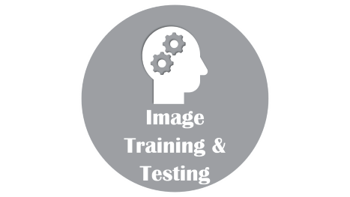
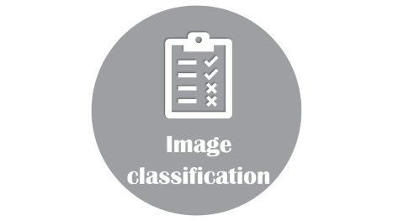
Image Processing

Slide 34
Image Training & Testing

Slide 35
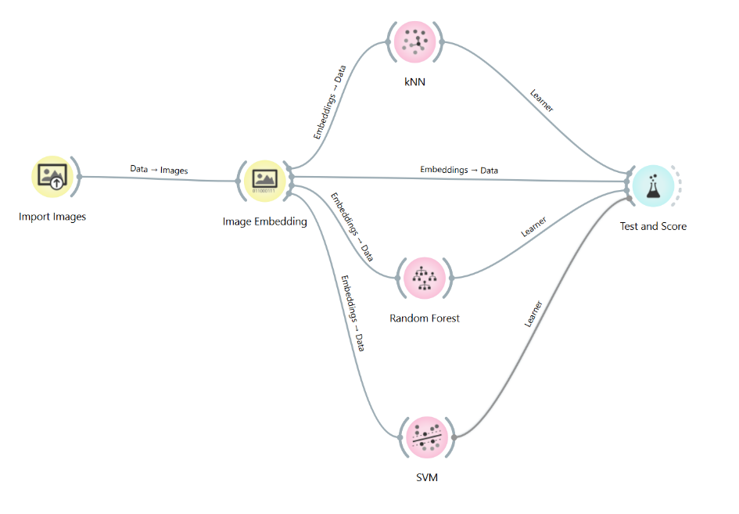

Image Training & Testing
image Training
Our purpose is to Prepare and Train the dataset before the prediction.
Before we train the data , we need to store the images as bits and bytes
Now , we train it using models
image testing
To test the training efficiency, we going to use “Test and Score” widget

Slide 37
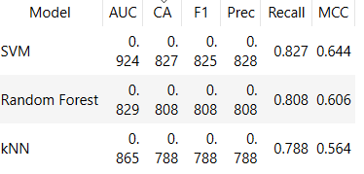
As we notice from the figure below “SVM” model has the highest “CA” that’s why we will rely on this model in training the data.

Slide 38

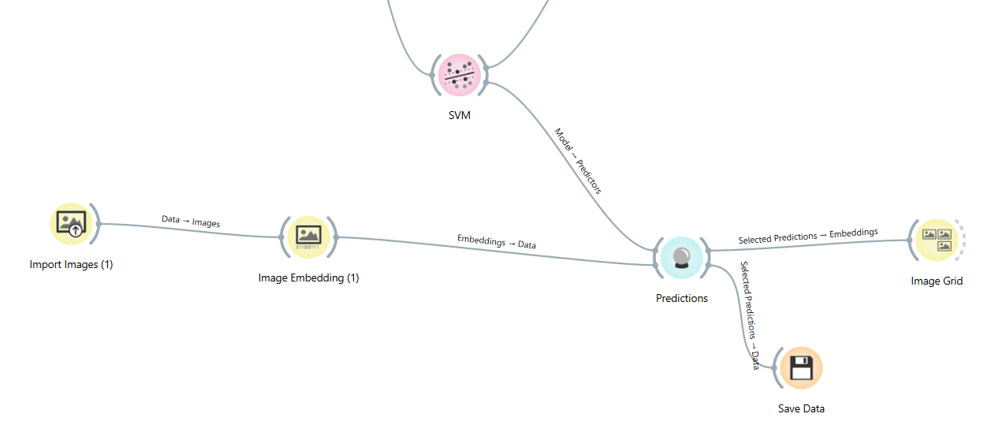
Image classification

Slide 39
Image classification
Now that the data is fully trained
We will use a different brain tumor image than those used during the training to detect the presence of a brain tumor

Slide 40
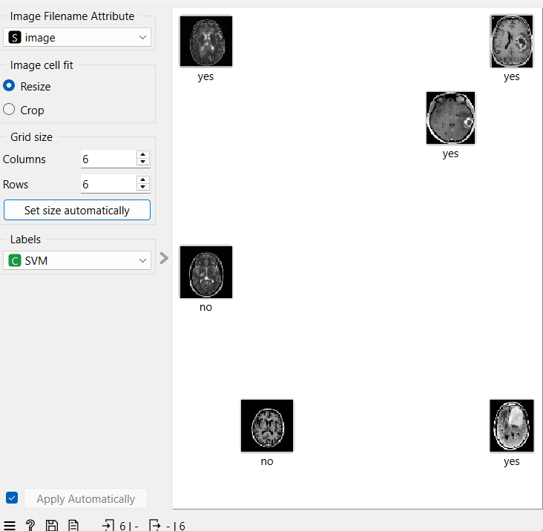
Image classification
Loan Approval Classification
We analyzed a dataset to build a model that can predict loan approval decisions.
Key insights included:
Balanced Dataset: 52% of instances were labeled as "NO" and 48% as "YES".
Preparing The Data:
Missing values were imputed
Data was normalized
Outliers were removed
Data was sampled into training and prediction sets
Training & Testing: We used several models, with Gradient Boosting showing the highest accuracy.
This model was then used for predictions
We connected the 'Predictions' widget to the 'SVM' model (Highest “CA”)
Then linked it to the new images and connected the predictions to the 'Image Grid' to visualize the results.

Slide 41

Results and Conclusion
.
Loan Approval Classification
We analyzed a dataset to build a model that can predict loan approval decisions.
Key insights included:
Balanced Dataset: 52% of instances were labeled as "NO" and 48% as "YES".
Preparing The Data:
Missing values were imputed
Data was normalized
Outliers were removed
Data was sampled into training and prediction sets
Training & Testing: We used several models, with Gradient Boosting showing the highest accuracy.
This model was then used for predictions
.•Brain Tumor Image Classification
We used MRI scans to train a model that can identify brain tumors.
Highlights included:
Best Model: SVM model was the highest accuracy
Predictions: The trained SVM model was then used to predict the presence of brain tumors in new images
In summary, we successfully built a machine learning model that predict loan approval and detect brain tumor

Slide 42
Thanks for listening
Results and Conclusion
.
Loan Approval Classification
We analyzed a dataset to build a model that can predict loan approval decisions.
Key insights included:
Balanced Dataset: 52% of instances were labeled as "NO" and 48% as "YES".
Preparing The Data:
Missing values were imputed
Data was normalized
Outliers were removed
Data was sampled into training and prediction sets
Training & Testing: We used several models, with Gradient Boosting showing the highest accuracy.
This model was then used for predictions
.•Brain Tumor Image Classification
We used MRI scans to train a model that can identify brain tumors.
Highlights included:
Best Model: SVM model was the highest accuracy
Predictions: The trained SVM model was then used to predict the presence of brain tumors in new images
In summary, we successfully built a machine learning model that predict loan approval and detect brain tumor

Slide 43

Thanks for listening
.
.•Brain Tumor Image Classification
We used MRI scans to train a model that can identify brain tumors.
Highlights included:
Best Model: SVM model was the highest accuracy
Predictions: The trained SVM model was then used to predict the presence of brain tumors in new images
In summary, we successfully built a machine learning model that predict loan approval and detect brain tumor
ANY
Questions

